Slide 1

JavaScript performance
Because it matters

Slide 2
Should we care about JavaScript performance?
Some people think - no

Slide 3
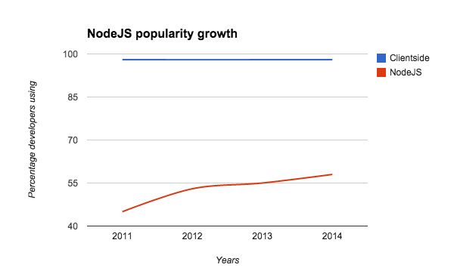
Big data and server side matters

Slide 4

How JavaScript
engine works?
Because engineer should
know how

Slide 5
Levels of JS engines optimization
Compiles JavaScript to native code via JIT
Creates hidden classes during run time to optimize access to objects
Functions optimizations
Deoptimization if too optimistic

Slide 6
Why JIT
was a game changer?
Classic interpretation flow:
JavaScript
Lexer
Parser
Translation
Interpreter
Native code
TOKENS
SYNTAXTREE
BYTE CODE

Slide 7

Lexer cuts JS code
Tokens samples: [1,2,’abc’], 1,
‘abc’, instanceof

Slide 8

Parser builds tree
Which describes how tokens
are connected and inherited

Slide 9
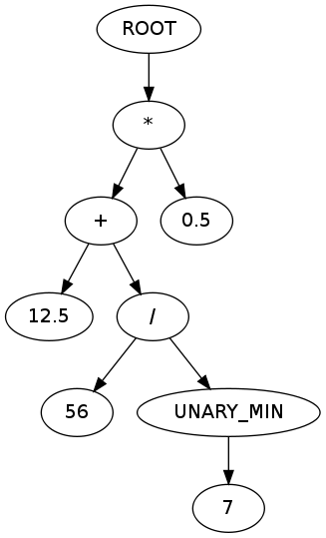

Slide 10

Translator converts
to byte code
Simpliest translator looks like
dirctionary of bytecode
commands or big switch operator

Slide 11

Interpreter
Converts byte code to native
and executes it. This takes a bunch of time every time you need to run some code

Slide 12
JIT
=
Just in time compilation

Slide 13

Challenge started
V8 vs SpiderMonkey vs Nitro

Slide 14

Hidden classes
Because JavaScript still
have a static typed soul

Slide 15
Always give browser a hint on a class expected
Bad | Good
var year; … year = 1985; | var year = 1985;

Slide 16

Inline caching
Keeping hidden classes
for further use

Slide 17
Define class properties in constructor
Bad | Good
var myClass = function(){}; … myClassInstance.left = 20; | var myClass = function(){ this.left = 10; }; … myClassInstance.left = 20;

Slide 18
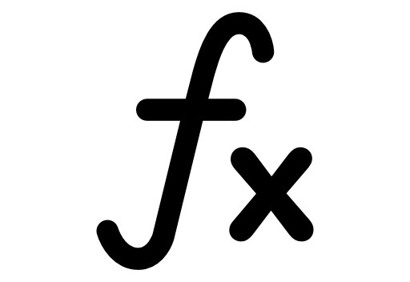
Functions inlining
Call replacement by body

Slide 19
Use small monomorphic functions
Bad | Good
function myFunc(){ ...100 lines } myFunc(1); myFunc([1,7,12,9]); | function myFunc(){ ...10 lines } myFunc(1); myFunc(12);

Slide 20
No nested functions
Since you redeclare
inner functions on every call

Slide 21

Fast numbers
Small integers vs doubles
15 - SMI (fast, value)
15.5 - double (slow, pointer)

Slide 22

Fast arrays /
slow hashtables
Array start with 0, have no gaps
Fast array contains only one type,
Faster array contains SMI

Slide 23
Prefer arrays over objects working with big data
The only excuse is a need to access by string index / key

Slide 24
Preallocate arrays < 64k
var arr = new Array(1000);
is a way faster than
var arr = [];

Slide 25
Other optimizations:
Hoisting out of the loop
for (var i = 0; i < arr.length),
arr.length will be calculated only once since browser now it should be hoisted

Slide 26
Other optimizations:
Constants folding
Caching of immutable data in order to calculate only once.

Slide 27
Other optimizations:
Dead code elimination
Let`s delete useless code

Slide 28

Caching,
memoization
Fastest way to accomplish task
is to skip it

Slide 29
Querying selector with caching
function searchNoCaching(selector) {
return document.querySelectorAll(selector),
}
function searchWithCaching(selector) {
return searchCache[selector] = searchCache[selector] || document.querySelectorAll(selector),
}
var searchCache = {};

Slide 30

jQuery is beautiful
Do not use it

Slide 31
Why not?
100 Kb on mobile? Come on!
Performance - sometimes 40 times slower comparing to native
Missing the future - native analogues evolving, becoming more and more performant. By sticking to jQuery you are missing cutting edge.

Slide 32
DOM is the bottleneck, write less to it
Append less to the actual document, use temporary in-memory nodes to accumulate changes and insert all at once then.

Slide 33
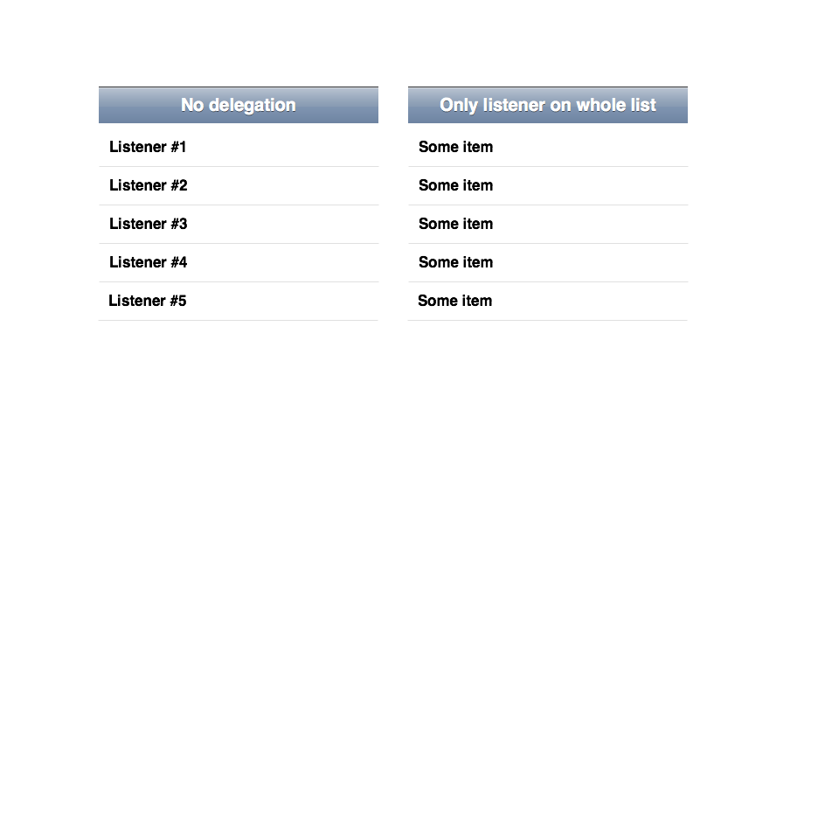
Events delegation

Slide 34
Check list
Define variable type initially
Define class properties in constructor
Integers are faster
Write small monomorphic functions
Avoid nested functions declaration
Use arrays starting from 0 index without gaps
All elements of array shoud have the same type, SMI is preferable

Slide 35
Check list
Do not use objects for big data unless you need key based access
Cache / memoize heavy calculations
Do not use jQuery
Write to the document`s DOM as less as possible
Use event delegation in lists

